Slide 1
ARV community delivery:
A non-inferiority cluster-randomized pragmatic trial in Dar es Salaam
Joel Msafiri Francis, Pascal Geldsetzer, David Sando, Gerda Asmus, Irene A. Lema, Eric Mboggo, Happiness Koda, Sharon Lwezaula, Ramya Ambikapathi, Wafaie Fawzi, Nzovu Ulenga, Till Bärnighausen
Differentiated Service Delivery Models
27 July 2018

Slide 2
We tested a new model of care: ARV community delivery
Implemented collaboratively by Management and Development for Health (MDH), Dar es Salaam, and the Harvard T.H Chan School of Public Health, Boston, in close collaboration with government
Specific research aims: To establish
Feasibility
Acceptability
Effectiveness
of ARV community delivery for patients who are stable on ART
Registered primary effectiveness endpoint: virological failure
Trial registration in the registry of the United States National Library of Medicine at the National Institutes of Health, clinicaltrials.gov (NCT02711293)

Slide 3
ARV community delivery has the potential to address critical ART capacity needs
Increasing need for ART delivery capacity that is affordable and can be easily scaled
HIV treatment is successful and clients live longer
Increasingly ambitious universal coverage goals for HIV-positive individuals
Public-sector ART clinics often overcrowded
Home-based carers (HBC)
A CHW cadre established by the Tanzanian government
Short training time
Supervised by community nurses and supported by MDH in Dar es Salaam

Slide 4
Why a non-inferiority trial?
If ARV community delivery produces the same or better health outcomes compared to standard of care, then it should become a policy option
Public-sector cost: HBC earn substantially lower salaries compared to nurses
Patient costs: community delivery reduces travel time and cost
Capacity: HBC can be trained quickly
Clinics: community delivery could reduce ART clinic patient load

Slide 5
We randomized all ART clinics in Dar es Salaam
NON-INFERIORITY CLUSTER RANDOMIZED PRAGMATIC TRIAL DESIGN
CHW
Intervention:
CHW supervised by community nurses
Community delivery of HIV treatment
Retention and adherence counseling
24 clinics
48 clinics
SoC
24 clinics
CHW = community health worker
Geldsetzer, Francis, Ulenga, Sando, Lema, Mboggo, Vaikath, Koda, Lwezaula, Hu, Noor, Olofin, Larson, Fawzi, Bärnighausen BMC Health Services Research 2017

Slide 6
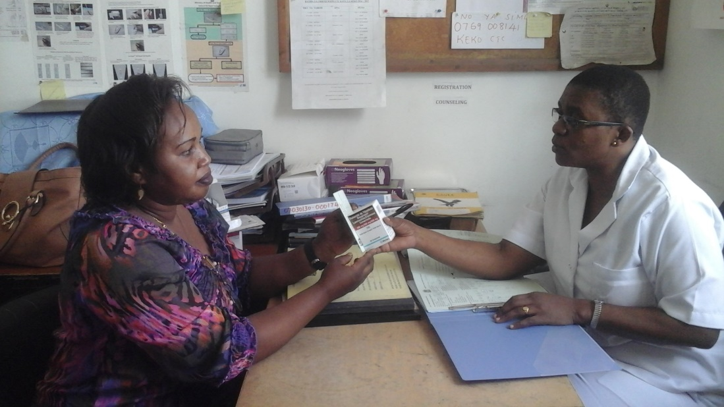
We provided additional training to existing HBC and community nurses for ARV community delivery
3 days of training
Focus on
HIV treatment
ART adherence
ARVs
Counseling skills
HIV prevention
Family planning
Basic nutrition
HBC in discussion with community nurse

Slide 7
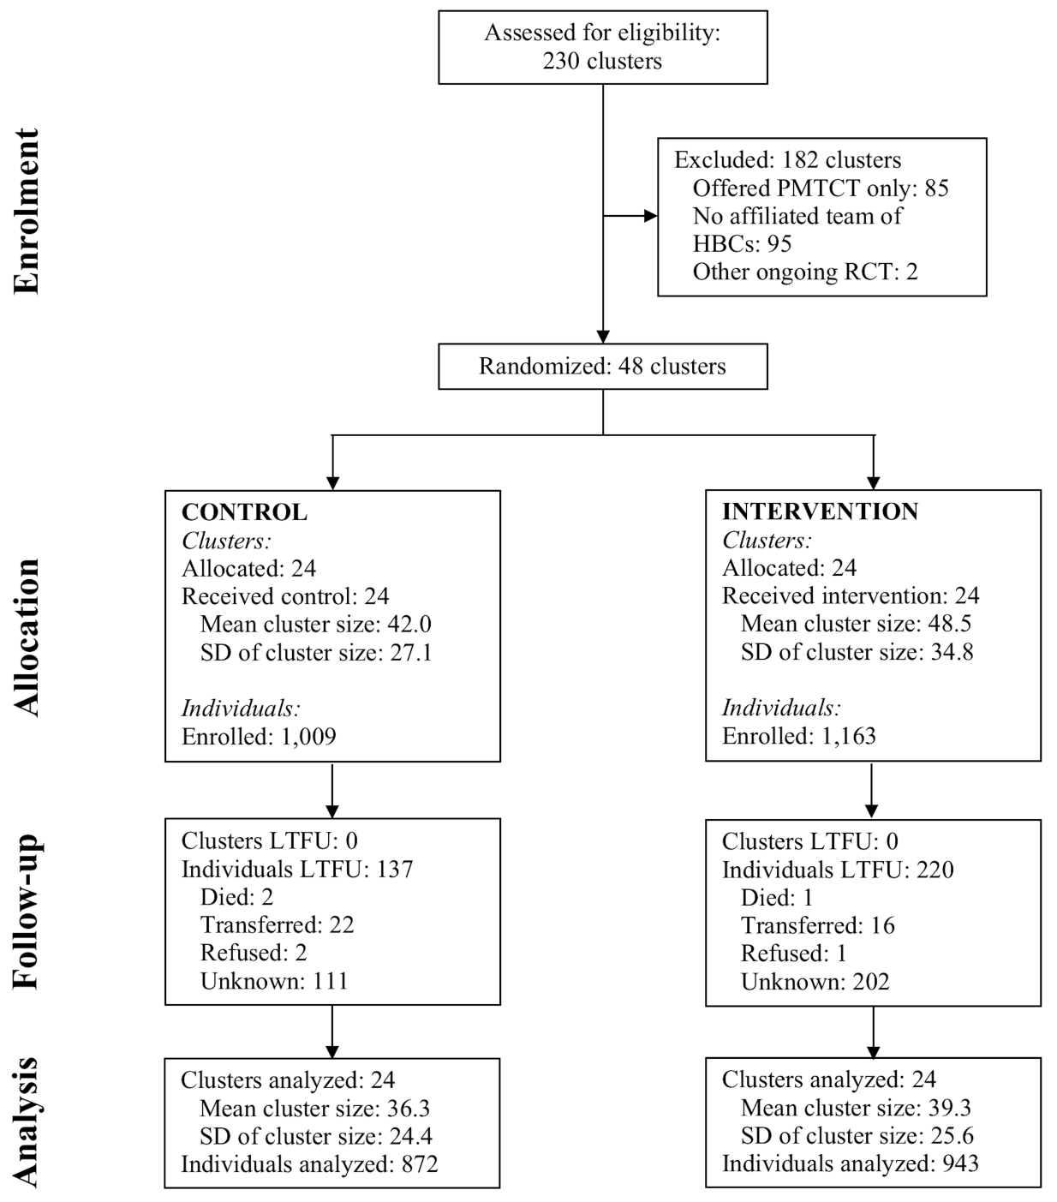
Patients living in clinic catchment areas were eligible
TRIAL FLOW DIAGRAM
Sample size
2,172 patients
1,163 intervention arm
1,009 control arm
Mean follow-up: 326 days
ARV home delivery in intervention arm:
44% of all patients
86% of all stable patients

Slide 8
Our registered primary analysis was intent-to-treat without adjustment
Primary ITT analysis using log binomial regression to estimate risk ratios
Secondary analyses
Baseline VL adjustment
Effects among only those who had a suppressed viral load at baseline
Complier average causal effect estimation using IV regression

Slide 9
ARV community delivery is as effective as a standard of care
PRIMARY TRIAL RESULT
CHW
SoC
Risk Ratio
P
Viral failure
(%)
9.7
10.9
<0.001
Non-inferior
Inferior
CHW = community health workers, SoC = standard of care

Slide 10
Satisfaction with ARV community delivery was high
ENDLINE SURVEY RESULTS
Overall, how satisfied or dissatisfied are you with this program of HBCs delivering HIV medicines into the communtiy?
Did the HBC deliver the HIV medicines on time?

Slide 11
Summary
Effective
ARV community delivery performs at least as well as standard of care in achieving the critical clinical endpoint viral suppression
Feasible
ARV community delivery implemented by existing public-sector health workers
Training of community health workers (HBC) and community nurses took 3 days
Acceptable
Large proportions of eligible patients chose ARV community delivery
Patient satisfaction with ARV community delivery was high
Providers agreed that ARV community delivery is a good strategy for public-sector HIV treatment

Slide 12
Next steps and policy implications
Ongoing analyses
Patient and public-sector cost studies
Economic evaluation
Contingent valuation
Policy translation
Six-monthly meetings with Ministry
Coordinator for Care at NACP team member
Policy engagement workshops
Policy considerations
Consider ARV community delivery as a policy option for urban Tanzania and other places in Africa
Long term follow up of clients received ARVs at home
Eliminate the clinic catchment area restriction

Slide 13
Thank you
Clients
Dar es Salaam City Municipalities
Health department
Agriculture department
Ministry of Health, Community Development, Gender, Elderly & Children
National AIDS Control Program
Funders: 3ie and BMGF
Study teams at MDH and Harvard TH Chan School of Public Health
MDH colleagues and management

Slide 14
Investigators
Joel Msafiri Francis, Pascal Geldsetzer, Sharon Lwezaula, Happiness Koda, Irene Lema, Eric Mboggo, Nzovu Ulenga, David Sando, Maria Vaikath, Ramadhani A. Noor, Ibironke Olofin, Wafaie Fawzi, Till Bärnighausen

